Slide 1
PYTHON..
Introduction

Slide 2
HISTORY
→Monty python’s flying circus (comedy series group)
→1991. at national research institute for mathematics and computer science in neither lands.
→broadcast →BBC(British broadcasting cooperation.)
→python was created as a successors of a language called ABC (All Basic Code).
→python is a backend programming language. But also used as scripting language (Django) → 2003 →2005

Slide 3
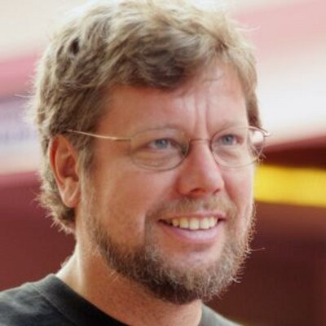
Creator of the python:-
Guido van Rossum

Slide 4
Advantages:-
1. Easy to code
2. Expressive → understandable and readable.
3. Extensible → your code in another language.
4. Free and open source. → https://www.python.org/download/
5. Embeddable →some code put in another language.
6. Large standard library
7. platform independent →code in any machine.
8. object oriented
9.dynamically typed language.
10. interpreted.
11.high level.
Disadvantages:-
1. speed
2. Mobile development

Slide 5
Organisations used in python:-
1. Google.
2. Yahoo(maps).
3. You tube.
4. Mozilla.
5, Dropbox.
6. Microsoft.
7. Cisco.
8. Spotify.
9. Quora.

Slide 6
Applications:-
1. web applications →Django/ flask frame works.
2. game Applications →pygame module.
3. AWS.
4. CAD/CAM.
5. IOT
6. AI
7. deveops.
8. GUI applications →tkinter module.

Slide 7
Definitions:-
python is a high-level multi-paradigm and general purpose programming language.

